Slide 1
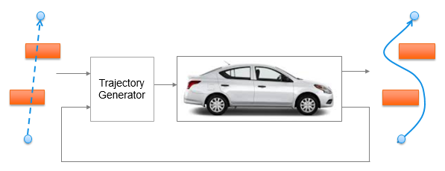
Trajectory Generation in High Density Environment
Final Review
Suvo Ganguli
Alberto Speranzon
Aug 01, 2018

Slide 2
Trajectory Generation in High Density Environment
Project Description
Trajectory generation in cluttered environment is a key problem to solve for autonomous operations
The goal of this project is to understand the trade-offs between the different parameters used to design trajectory generation in presence of obstacles
Planned Deliverables
- Develop 2D trajectory generation algorithm
Perform design trade-off studies
- Develop alternate 2D trajectory generation algorithm which is computationally efficient
Perform comparative and robustness studies
Team Members
Suvo Ganguli
Alberto Speranzon

Slide 3
Basic Concepts
Local Planner
Global Planner
Local Planner – generates trajectory for a part of the path. Example:
MPC (Model Predictive Control)
Global Planner – generates trajectory from start to goal point. Example:
Laplacian
MPC
MPC Planner generates a trajectory by
Solving an optimization problem for multiple time steps in future
Taking a single time step, and repeating optimization
Does take into account vehicle kinematics and constraints
Laplacian Planner generates a trajectory by
Assigning +1 potential to start point, zero potential to obstacles and -1 potential to goal point
Finding optimal path using gradient descent
Does not take into account vehicle kinematics and constraints
o
o
MPC
o
o
o
o
o
o
Time Step k
Time Step k+1
-1
Laplacian
0
+1

Slide 4
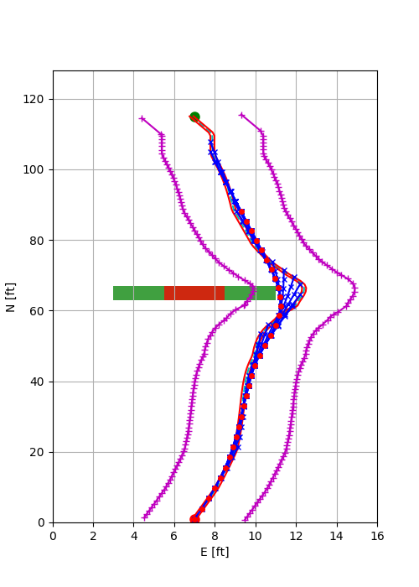
Approach 1 (Mid Term)
Global planner – Laplacian
Local planner – MPC
Laplacian path
Laplacian path
Boundary for terminal point
MPC path
Boundary for all points
MPC path at time step k
Final path point
Obstacle with safety margin
Current location
Algorithm:
Compute Laplacian path from start to goal point
At every MPC time step, set final point in the horizon is “near” the Laplacian path
Use the first point in the horizon to generate the next point of the final path
Result: Final path from start to goal point satisfies vehicle dynamics and constraints (since MPC path does)

Slide 5
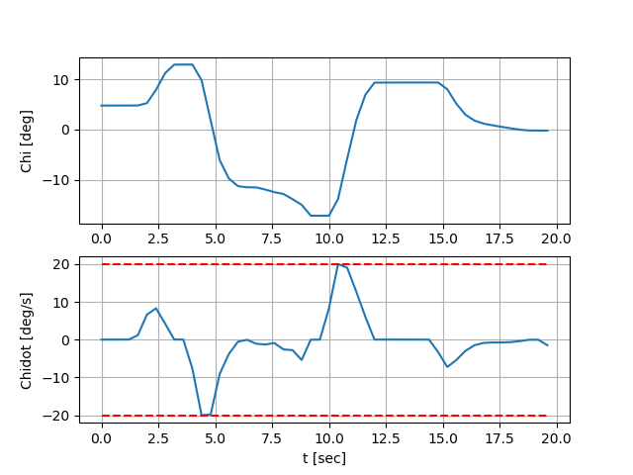
MPC Problem Setup
Minimize cost function with following components:
Sum of
Distances of MPC trajectory points from Laplacian trajectory (state cost)
Velocity errors (state cost)
Accelerations (control cost)
Heading Rates (control cost)
Subject to constraints:
Vehicle kinematics (nonlinear)
Control limits for all trajectory points
Distance of MPC trajectory points from Laplacian trajectory (narrower for terminal point)
Lateral acceleration
Limit of velocity errors
Corresponds to two turns to avoid two obstacles

Slide 6
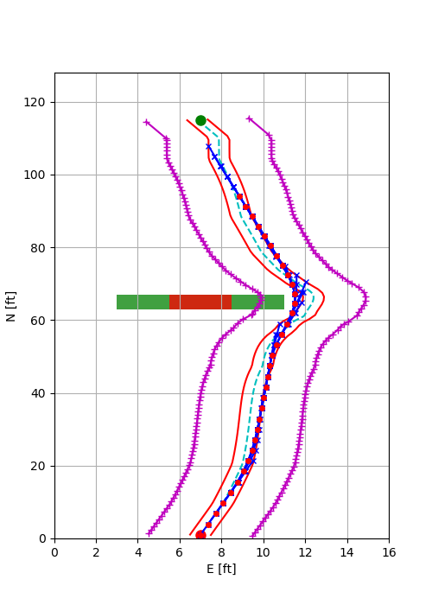
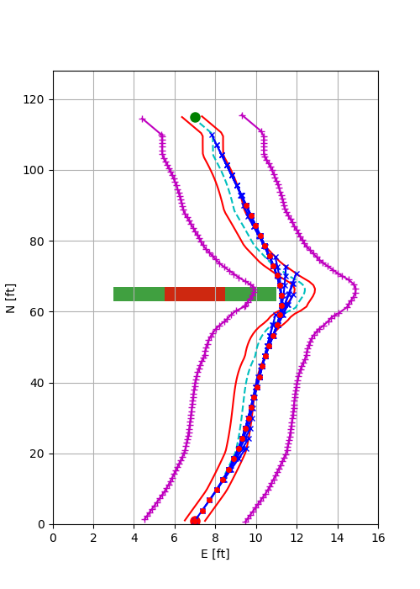
Tradeoff Parameters
N = 6
Our goal is to trade off the following
Computation Time
averaged over the entire simulation
Trajectory Smoothness
cornering distance
Control Effort
integrated acceleration and heading rate
Comfort Level
1/integrated acceleration
with
Number of MPC time steps (N)
Number of Obstacles (no)
Tradeoffs
Computation time (CT) increases with N (CT ~ 2^{N})
Computation time increases with no (CT ~ 1- k.e^{-b.no})
For a specific size and location of obstacles
N = 8
wider turn
(smoother trajectory)

Slide 7
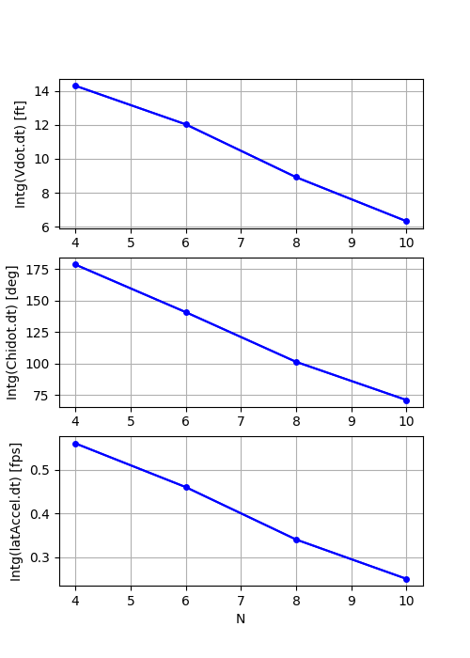
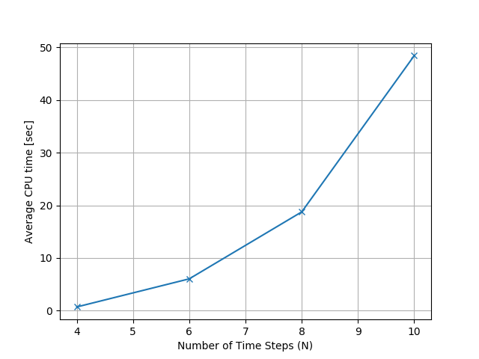
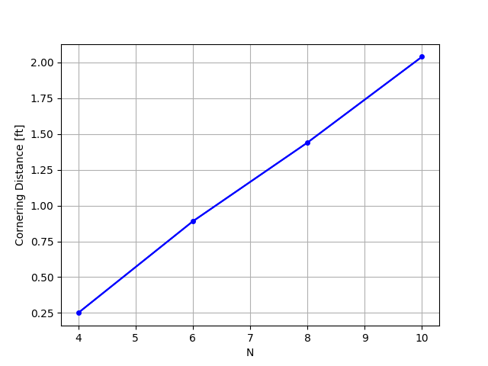
Summary of Design Tradeoffs
Increase in N (equivalent to horizon distance) leads to:
Smoother Trajectory
Decrease in Control Effort
Increase in Comfort Level
At the cost of
Increase in Computation Time
Control Effort
(acceleration)
Computation time
Trajectory Smoothness
Control Effort
(heading rate)
1
Comfort Level
No. of Time Steps (N)
No. of Time Steps (N)
No. of Time Steps (N)

Slide 8
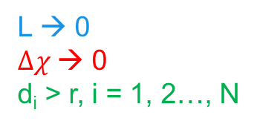

Approach 2 (Final Term)
Global and local planner – MPC
MPC problem minimizes the cost function with following components:
Velocity errors for all points
Accelerations for all points
Heading rate of all points
Relative heading of the goal point w.r.t. the terminal point of the MPC horizon
Distance between the goal point and the terminal point of the MPC horizon
MPC constraints include
Limits on acceleration and heading rate
Distance between MPC points and obstacle greater than radius of safe region around obstacle
Maximum heading error of terminal point
$$Δχ$$
L
L → 0
$Δχ$→ 0
d_{i} > r, i = 1, 2…, N
r
d_{i}

Slide 9
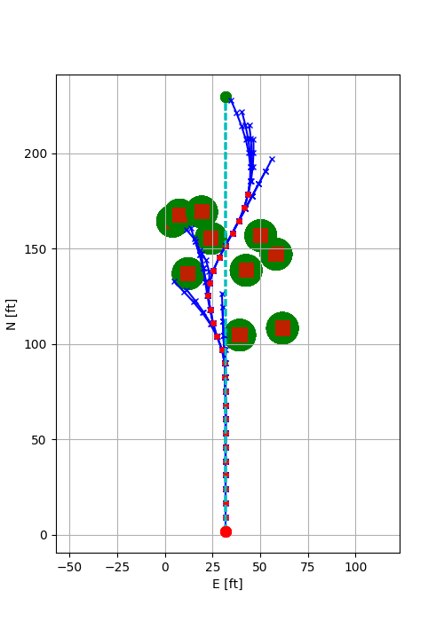
Analysis with 2nd Approach
Comparison with 1st Approach
Can avoid obstacles not known a priori
Does not need a separate global planner
Avoid costly re-computation of Laplacian planner (2X-3X reduction, more reduction with larger grids)
Robustness Study
100 test cases with 10 obstacles (pop-up)
99 out of 100 test cases successfully generated trajectory
Specific test cases to analyze occasional failure
MPC Horizon
MPC Path
Avoid getting trapped
Obstacles with Safety Margin
Obstacle 3
Obstacle 1
Field of View
Honeywell Internal
Notes:
Honeywell Internal
8

Slide 10
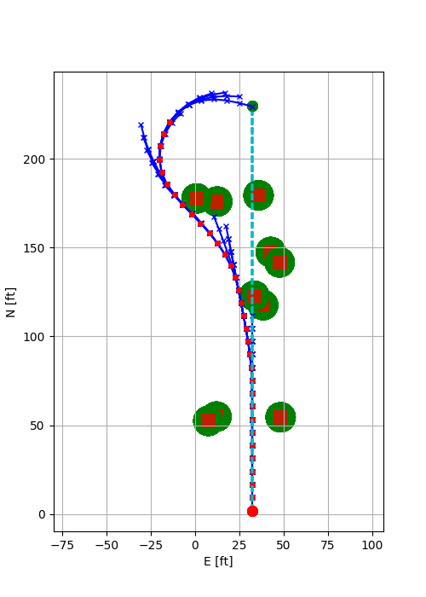
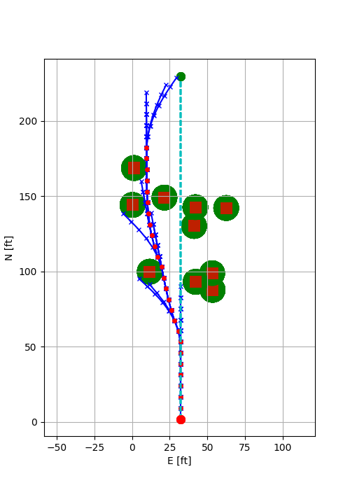
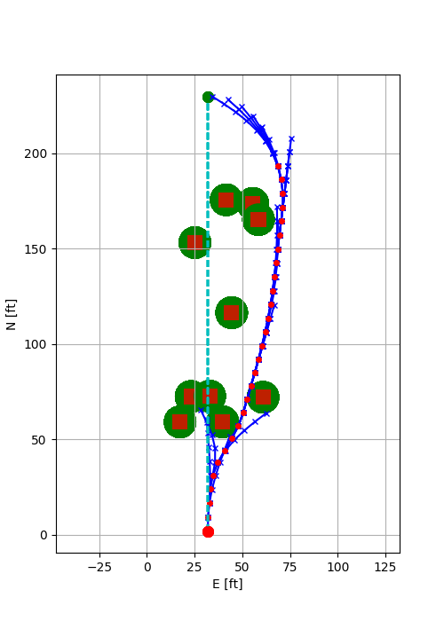
MPC Randomized Test Cases
MPC Trajectory Generator relative heading constraint reduces from 90 deg when no obstacles are in view
MPC Trajectory Generator changes the heading of the path upon finding less “costly” path
Honeywell Internal
Notes:
Honeywell Internal
9

Slide 11
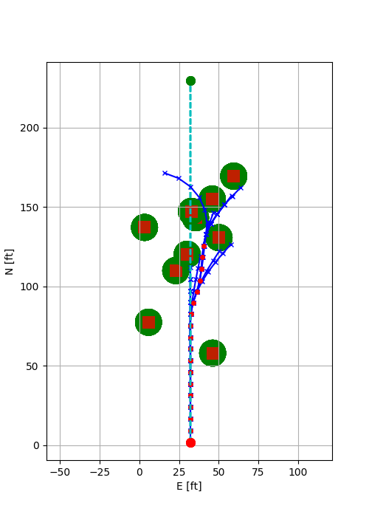
MPC Trajectory Generator is trapped and unable to progress farther.
It turns right to follow the less “costly” path until it views another obstacle for which no feasible path can be generated.
MPC Randomized Test Cases
MPC Trajectory Generator changes the heading of the path upon a “dead end”
Obstacle 3
causes infeasibility
Would have lead to longer trajectory
Honeywell Internal
Notes:
Honeywell Internal
10

Slide 12
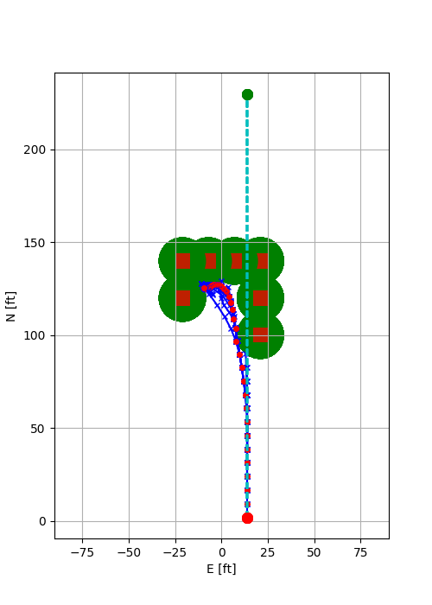
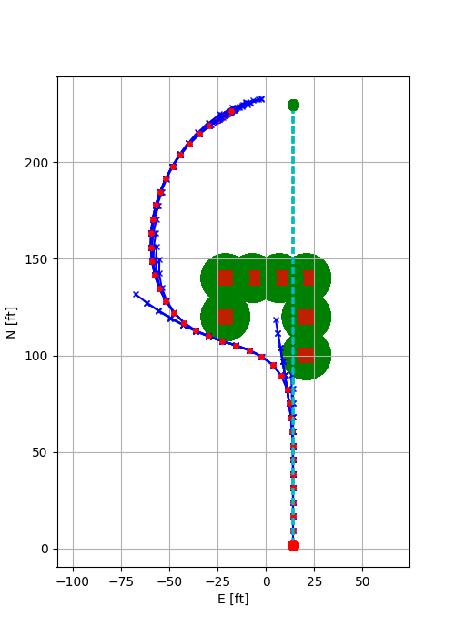
MPC Specific Test Cases
MPC Trajectory Generator is trapped and slows down to zero speed due to tighter turn constraint
MPC Trajectory Generator successfully reaches the goal point with relaxed turn constraints
Tighter turn constraint
Relaxed turn constraint
Honeywell Internal
Notes:
Honeywell Internal
11

Slide 13
Project Results versus Objectives
Describe the project results and compare the results to the original objectives
Use graphics and photographs as much as possible
Describe the intellectual property created and how it has been protected (WIDS, patent application, trade secret, etc.)
Approx. 10 minutes

Slide 14
What’s Next for This Technology
WIDS
Dynamically Feasible Trajectory Generator
Dynamic feasibility is not considered in many traditional algorithms
Novel combination of MPC and Laplacian trajectory generation to achieve dynamically feasible trajectory
Expand the technology to include
3D trajectory generation with application to UAVs
Dynamic obstacles
Efficient path re-rerouting upon hitting dead-ends (using Probabilistic Road Maps)
Obtained IR&D funding to continue development
Optimize the software for real-time application
Questions?

